Slide 1
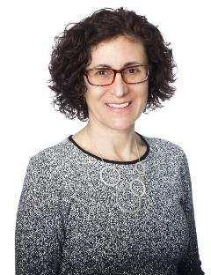
Guest Speakers
Anesu Machoko, CEO and Founder MetaDigital
linkedin.com/in/anesu-machoko/
Jacqueline Friedland, Canadian Institute of Actuaries (CIA) President
linkedin.com/in/jacquelinefriedland

Slide 2
November 5th, 2021
Semi-Annual Meeting
Notes:
Welcome to WAC business portion of the meeting today

Slide 3
2021 WAC Executive
Co-Presidents
Aaron Yanofsky, Canada Life
Cody Baldauf, Canada Life
Treasurer
Kelsey Hingey, Canada Life
Secretary
Alyssa Vergata, Canada Life
(term ending – seeking new candidate)
Member at Large
David Senensky, Canada Life
Tristan Shute, Wawanesa (newly elected)

Slide 4
Agenda
Treasurer’s Update
Member-at-Large Update
WAC/UMAC Mentorship Programme
Vote: New Secretary to be elected
Logo Contest Kickoff
WAC Plans for 2022

Slide 5
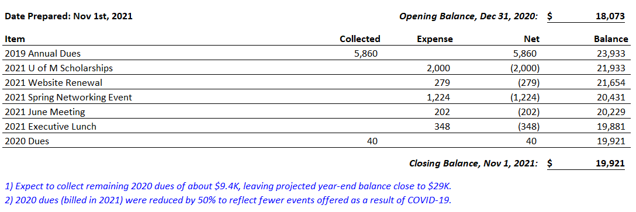
Treasurer’s Update
Financial Statement – November 2021
Notes:
update on state of finances, decision to lower membership dues
Put emphasize on volatility of cashflow streams, peaks/troughs, etc.

Slide 6
Member-at-Large Update
Next Networking Event: February/March
WAC Scholarship Process Changes
2021 WAC Scholarship Winners
  Luke Alevizos
  Anna Kowalchuk
U of M Math Contest Results
  Robert Craigen, University of Manitoba
Notes:
David: We will be hosting our next networking event in February/March. We are looking into the possibility of doing an in-person event, but we will assess the situation as the date comes closer. We will also send out a poll to get the groups thoughts on an in-person event vs a networking event.
Tristan: As you know, we host a WAC scholarship every year.
Starting this year, we have made the following changes to the way the WAC Scholarship works. The changes are as follows:
Eligibility changes: Students who use University Accreditation Program are now eligible for the scholarship
Focus on well roundedness vs just GPA: The scholarship application has been updated this year to try and reward well rounded students via the requirement to submit a short letter demonstrating leadership
In 2021, I’m happy to announce that the WAC Scholarship Winners are Luke Alevizos and Anna Kowalchuk
Aaron: Speak to the UofM Math Contest Results

Slide 7


WAC/UMAC Mentorship Programme
Kicked-off for the 2021/2022 school year
40 WAC mentors
66 UMAC students
THANK YOU to all volunteers

Slide 8


CIA Career Days
CIA initiative to create awareness and opportunity in the profession
Promote diversity and inclusion
Manitoba selected for the pilot
Participated in 2 career days at Gray Academy
High school connections? (Contact Alyssa!)
Would you like to participate? (Contact Alyssa!)

Slide 9
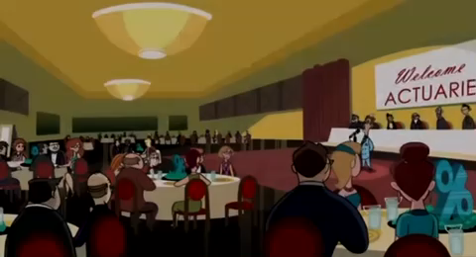
CIA Career Days
Reminder: Sound
Notes:
Reminder: TURN ON SOUND

Slide 10
Vote: Election of new Secretary
Term will last until the Fall 2023 WAC meeting
Only WAC members are eligible to vote
Secretary duties include:
  Documenting meeting minutes and distributing all Club communications including email voting to members
  Keeping record of members and emails
  Providing RSVP information gathered for all meetings to Board member leading the event
  Maintaining the Club’s website
  Participation in Board quarterly meetings
Notes:
1) Open the floor to members interested in filling role XXXX on the executive as member XXX is stepping down from two year rotation/or the role XXX that is currently open
2) Ask for any nominations
3) Ask for candidate(s) approval (if in attendance, otherwise someone to confirm their approval on their behalf)
4) Open the floor to a vote by raise of hand (if we have more than one candidate nominated)
5) Ask for a second motion (only if there is no vote required)
6) Congratulate new member

Slide 11




Logo Contest Kickoff
Prize: $200.00 to the winner
Submission details
  Send digital copy to any member of the WAC Executive
  Open to both WAC and UMAC members
  Contest closes December 31, 2021
Winning submission will be selected in early 2022 via:
  Preliminary review by the WAC Executive
  Vote by the WAC Membership
Notes:
Last meeting we gauged interest in the potential for this contest, which had support

Slide 12
WAC Plans for 2022
Continue existing programming
Additional plans:
  WAC Volunteer Event
  Bring back WAC Golf Day – Summer 2022
  Look for new ways to invest in & support our club’s mission of:
    providing its members with networking opportunities to foster members’ professional and technical growth.
    supporting the development of Manitobans who aspire to a career in the actuarial profession.
Notes:
Career day with CIA - anything to update?
Volunteer event/day in 2022.
Do we want to have a vote on potential options? i.e. Siloam Mission, Agape Table, Winnipeg Harvest, Habitat for Humanity, etc.
We would need to investigate this further, so perhaps this is a bit premature.
Return of the WAC golf tournament in 2022.
Ideas of spending the WAC surplus?
We could have an idea gathering session? I think the ultimate decision will lie with the WAC exec to make a decision. And our spending should align to our club's mission statement -
networking opportunities to foster members’ professional and technical growth.
supports the development of Manitobans who aspire to a career in the actuarial profession..
Ideas:
Bring in a more notable guest speaker?
Increase WAC U of M scholarships, or Math Contest Reward.
Support UMAC, and what is an actuary outreach programme?

Slide 13
Questions from the Membership
Please feel free to bring up any WAC-related topics

