Slide 1

Spring 2024
WAC Semi-Annual Meeting
Wednesday, May 29th, 2024
Join at slido.com
#WAC2024

Slide 2
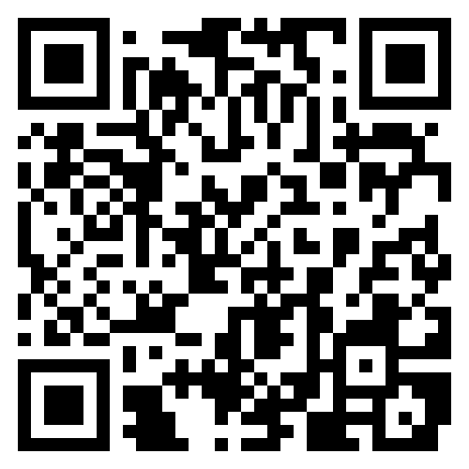

Agenda
11:00am – Welcome Reception & Registration
11:15pm – Risks in Agriculture Panel Discussion
12:00pm – WAC Business Session
12:15pm – Buffet Lunch
Feedback Survey
Join at slido.com
#WAC2024
Notes:
Hello everyone!
Thanks for coming to the Fall 2023 WAC Semi-Annual Meeting
We are excited to see everyone here today
We’ll be starting our presentations shortly.
We’ll be using Slido to submit questions for the Q&A after the panel. Please log in now with the code WAC2023 as shown on the screen.
Feel free to submit questions during the presentations. Once our 3 panelists have presented, we’ll move onto the Q&A portion.
To kick us off, we’ll do a poll for fun.

Slide 3


What are you looking forward to this summer?
ⓘ Start presenting to display the poll results on this slide.
Notes:
Please add your favorite fruit.
…
Okay great!
Now I’d like to kick off the presentations on agriculture risks.
First up, I’ll welcome William Pallister to the stage (read bio)
William is a 5th generational farmer out of Portage la Prairie. He grew up around Portage, helping out around the farm through his childhood. He graduated with a diploma in Agriculture from the University of Manitoba, followed by a degree in Agribusiness. He co-operates and partly owns a 19,000 acre grain farm with his dad, brother, and many staff. He and his wife Jenna recently had their first child, welcoming Lowen 8 months ago.
Please join me in welcoming, William!

Slide 4
(Panelists Presentations)
Notes:
William Pallister
Rick Steinke
Jared Munro

Slide 5

Audience Q&A Session
ⓘ Start presenting to display the audience questions on this slide.
Notes:
Aaron to moderate

Slide 6
WAC Business Session
Notes:
[Aaron]
We hope you enjoyed the discussion on Agriculture Risk
Thanks to our incredible panelists for joining us (*applause*)
[Quinn]:
We’ll run though our business update here before enjoying buffet Lunch back in the Main Hall

Slide 7
WAC General Business Update
Agenda
WAC Executive Opportunities
Recent & Upcoming Events
CIA Sponsorship
Financials
Initial Survey Results
UMAC Sponsorship
Notes:
[Quinn]:
Here are the main items to share since our last semi-annual meeting, which we’ll run through over the next few slides:
We’ll talk about:
The two Scholarships WAC offered to U of M students
The Habitat for Humanity event hosted in September
Vote on constitution updates
Discuss upcoming networking event
Our treasurer, Karl, will give us an update on the WAC finances
Then we’ll discuss the UMAC mentorship program
Lastly, we will present a UMAC Sponsorship Proposal

Slide 8
WAC General Business Update
Executive Opportunities
No positions are currently up for election
3 positions up for election in the Fall 2024 meeting
  Co-President (currently Quinn Pallister)
  Member at Large (currently Tim Rempel)
  Treasurer (currently Karl Sanderson)
Please reach out to the individuals above for more information if you are interested in any of these positions!
Notes:
[Quinn]
This meeting, there is 1 executive position up for election: Co-President (currently held by Aaron Yanofsky)
We would like to thank Aaron for all his incredible work and effort.
Requires nominations.
Co-President candidates: Braeden Hamm, Kate van Harrewyn
Get nominations
Invite them up to stage for a 1-2 min pitch
Send out email vote after the meeting (voting to close 5pm next day)

Slide 9
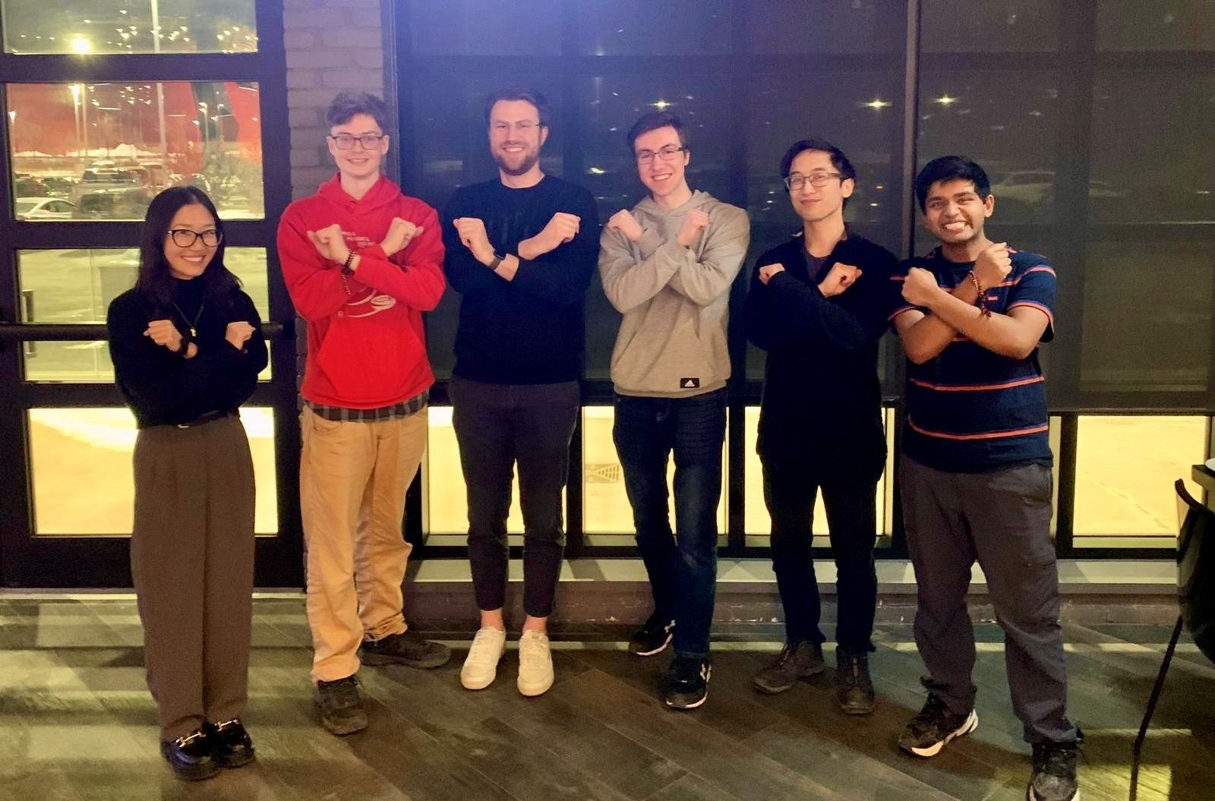
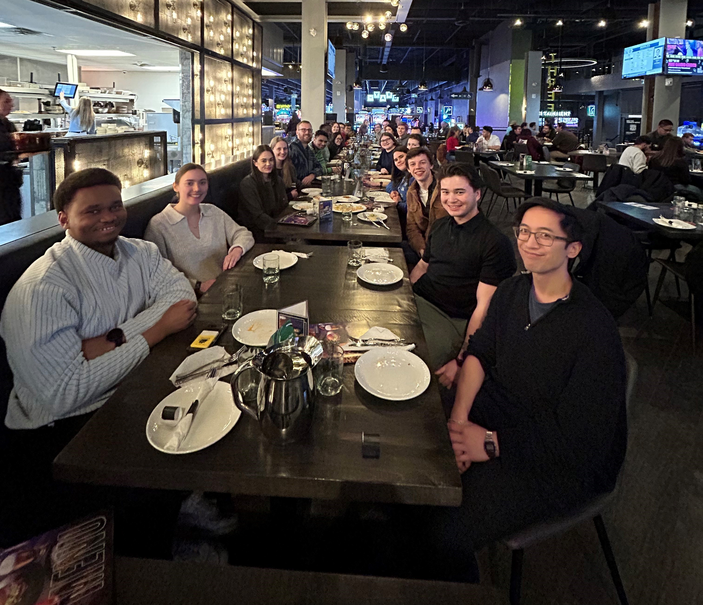
WAC General Business Update
WAC/UMAC Rec Room Event
Upcoming Events
Summer event & volunteer event
  TBD based on survey feedback

Slide 10
WAC General Business Update
CIA Sponsorship
CIA providing annual $3,000 sponsorship to use as we see fit
In return:
  CIA President Elect will present at the Fall meeting
  Mention of CIA sponsorship on Fall meeting communication

Slide 11
WAC General Business Update
Financials
All dues collected for 2022
Majority of dues collected for 2023
Financial position for club is strong compared to what was presented at Fall 2023 Meeting

Slide 12
WAC General Business Update
Initial Survey Results
30 responses so far – encourage more to submit feedback!
Membership generally satisfied with WAC’s current activities
Neutral responses on doing more to further the 3 main pillars of the club (networking, fostering professional & technical growth, supporting students)
  Pillar with most positive support is encouraging networking
Room for improvement in terms of quality of networking/social events
  Strong interest in future wine tasting event
  Mixed results for Golf Day
  Low interest in Habitat for Humanity volunteer day
Other themes in freeform feedback
  Assign tables at lunches to encourage networking
  Leave more time for lunch after presentations
  Provide more notice for events
  Common presentation topics: Sports, climate change, AI
Feedback Survey

Slide 13
WAC General Business Update
UMAC Sponsorship Proposal
Recap WAC Mission:
  The Winnipeg Actuaries’ Club (WAC, or the Club) is a local association that provides its members with networking opportunities to foster members’ professional and technical growth. The WAC also supports the development of Manitobans who aspire to a career in the actuarial profession.
Proposal:
  The WAC Executive has been approached by the University of Manitoba Actuarial Club’s Executive to create a $1000 annual sponsorship, payable between May – August.
  This sponsorship would directly align with WAC mandate to support the development of Manitoban’s who aspire to a career in the actuarial profession.
  Note: This proposal has been reviewed for financially feasibility by WAC’s Treasurer.
Notes:
First, a re-cap on WAC’s mission, which is to provide its members with networking opportunities to foster members’ professional and technical growth. The WAC also supports the development of Manitobans who aspire to a career in the actuarial profession.
UMAC has approached us with proposal for WAC to contribute $1000 annually
This sponsorship would align with WAC’s mandate to support Manitoban’s who aspire to a career in the actuarial profession
The WAC treasurer has reviewed this for financial feasibility

Slide 14
WAC General Business Update
UMAC Sponsorship Proposal
Message from UMAC Co-Presidents Matthew Lehmann and Tara Cyr
  UMAC is a very important resource contributing to the success of actuarial students at the U of M
  Largest event of the year is the Fish Dinner, hosted every year in October
    The costs to host this have increased substantially
  Cashflow issues for the club since university funding comes throughout the school year, between September and April, with most coming in the latter half of the year
    Difficult to budget for other development events in the Fall Term during recruitment season
  Requesting a yearly sponsorship from WAC to ease these financial difficulties the club faces the first half of the year. It would also allow us to grow find new ways to support our students
  Some examples on how the funds would be used include:
    Subsidizing student travelling costs to participate in ASNA networking event
    Subsidizing student costs for Fish Dinner, and other recruiting events.
Notes:
[Aaron]
Here are the details of the proposal. The UMAC co-presidents Matthew Lehmann and Tara Cyr have sent the following
main points are on slide
Meeting Voting Procedures:
A motion and a seconder to the motion must be made to begin a vote.
I motion to begin the vote on whether or not to sponsor UMAC
Aaron second the motion
A quorum for the transaction of any meeting vote shall be defined as the number of members in attendance.
Approval of a meeting vote requires a majority vote, except for the establishment of another Committee, which requires the approval of two-thirds of the members present at the meeting.
Go to poll on next slide

Slide 15

Do you support WAC creating an annual sponsorship to UMAC of $1000 to help fund their initiatives?
ⓘ Start presenting to display the poll results on this slide.

Slide 16
Open Floor
Feedback Survey
Notes:
[Aaron]:
And that concludes the formal part of the meeting – We will now open the floor if you have any questions, comments, or concerns.

Slide 17
Enjoy Lunch in the Main Hall!
Feedback Survey
Notes:
Please enjoy the buffet lunch in the hall. We encourage you to chat with actuaries you may not already know.
Thank you so much!

