Slide 1
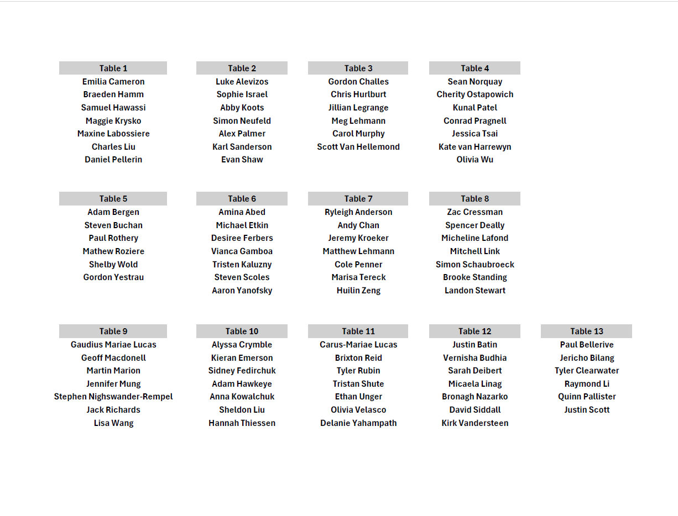

Slide 2

Fall 2025
WAC Semi-Annual Meeting
Thursday, December 11th, 2025
Join at slido.com
#WACF2025

Slide 3

Agenda
11:30am – Welcome Reception & Registration
11:40am – Buffet Lunch
12:15pm – Speaker: Institute for Catastrophic Loss Reduction
12:45pm – Speaker: Canadian Institute of Actuaries
1:15pm – WAC Business Session
Join at slido.com
#WACF2025
Notes:
Hello everyone!
Thanks for coming to the Fall 2023 WAC Semi-Annual Meeting
We are excited to see everyone here today
We’ll be starting our presentations shortly.
We’ll be using Slido to submit questions for the Q&A after the panel. Please log in now with the code WAC2023 as shown on the screen.
Feel free to submit questions during the presentations. Once our 3 panelists have presented, we’ll move onto the Q&A portion.
To kick us off, we’ll do a poll for fun.

Slide 4
Institute for Catastrophic Loss Reduction
Emilia Cameron
Join at slido.com
#WACF2025
Notes:
First up, we’d like to welcome our 3 panelists
Garett Klus
Yelena Kropivnitskaya
Parama Ray
(read bios)
Please join me in welcoming, Garett, Yelena and Parama!

Slide 5



Do not edit
How to change the design
Audience Q&A
The Slido app must be installed on every computer you’re presenting from

Slide 6
Canadian Institute of Actuaries
Daniel Pellerin
Join at slido.com
#WACF2025
Notes:
First up, we’d like to welcome our 3 panelists
Garett Klus
Yelena Kropivnitskaya
Parama Ray
(read bios)
Please join me in welcoming, Garett, Yelena and Parama!

Slide 7
Do not edit
How to change the design
Audience Q&A
The Slido app must be installed on every computer you’re presenting from

Slide 8
WAC Business Session
Notes:
[Aaron]
We hope you enjoyed the discussion on Agriculture Risk
Thanks to our incredible panelists for joining us (*applause*)
[Quinn]:
We’ll run though our business update here before enjoying buffet Lunch back in the Main Hall

Slide 9
WAC General Business Update
Agenda
Recent & Upcoming Events
U of M Scholarship Winners
Financials
Executive Election
Notes:
[Quinn]:
Here are the main items to share since our last semi-annual meeting, which we’ll run through over the next few slides:
We’ll talk about:
The two Scholarships WAC offered to U of M students
The Habitat for Humanity event hosted in September
Vote on constitution updates
Discuss upcoming networking event
Our treasurer, Karl, will give us an update on the WAC finances
Then we’ll discuss the UMAC mentorship program
Lastly, we will present a UMAC Sponsorship Proposal

Slide 10
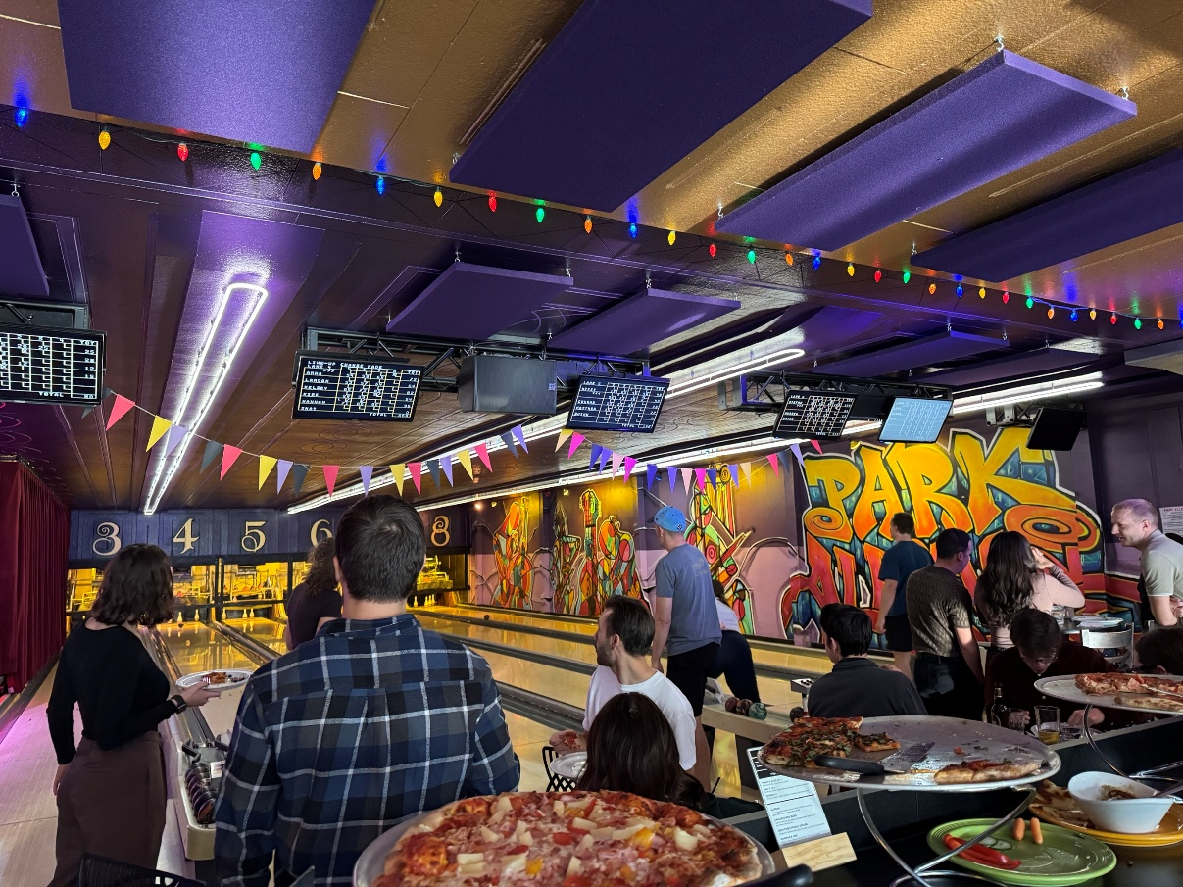
WAC General Business Update
Networking Events
Fall 2025 Event
Park Alleys Bowling
Upcoming Events
Volunteer Events
January 22nd – Harvest Manitoba
February 6th – Siloam Mission
Spring Event

Slide 11
WAC General Business Update
U of M Scholarships
Winnipeg Actuarial Club Scholarship Recipient
  Sawyer Mackid
Winnipeg Actuarial Club Equality of Opportunity Scholarship Recipient
  Sukhman Khaira

Slide 12
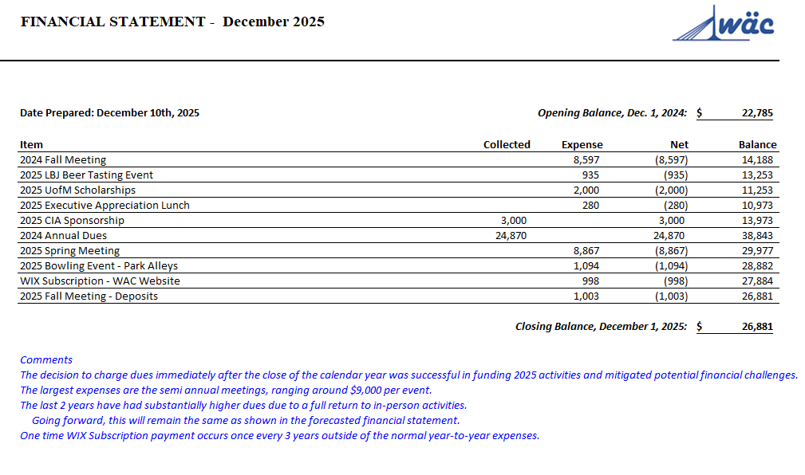

Slide 13
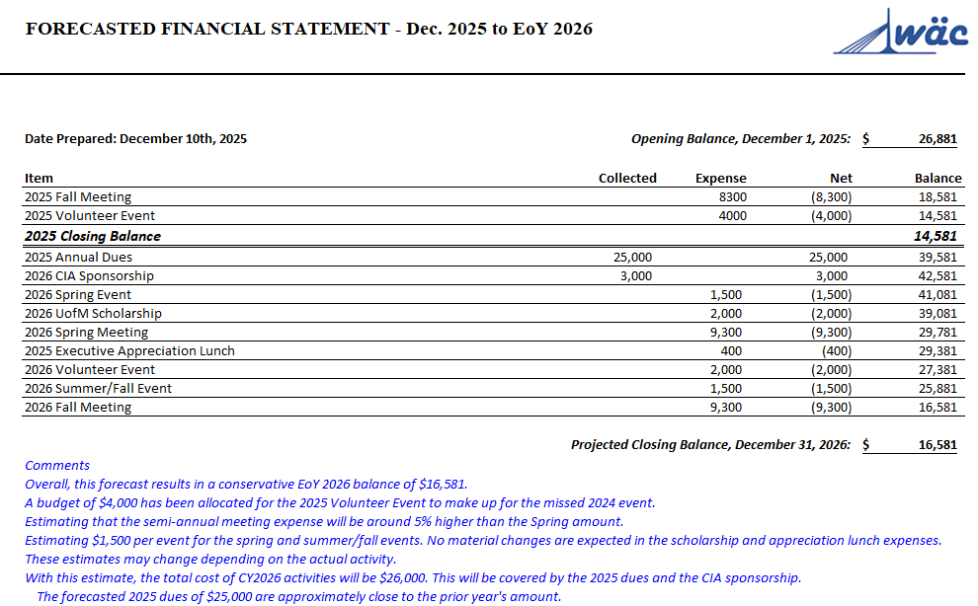

Slide 14
WAC General Business Update
Executive Election
Positions up for Election
Co-President (currently held by Braeden Hamm)
Member at Large (currently held by Shine Wang)
Secretary (currently held by Charles Liu)
Meeting Voting Procedures:
A motion and a seconder to the motion must be made to begin a vote.
A quorum for the transaction of any meeting vote shall be defined as the number of members in attendance.
Approval of a meeting vote requires a majority vote, except for the establishment of another Committee, which requires the approval of two-thirds of the members present at the meeting.

Slide 15
Open Floor
Notes:
[Aaron]:
And that concludes the formal part of the meeting – We will now open the floor if you have any questions, comments, or concerns.

