Slide 1

Spring 2025
WAC Semi-Annual Meeting
Wednesday, May 28th, 2025
Join at slido.com
#WAC2025

Slide 2

Agenda
11:30am – Welcome Reception & Registration
11:40am – Buffet Lunch
12:15pm – AI & Analytics Panel Discussion
1:00pm – WAC Business Session
Join at slido.com
#WAC2025
Notes:
Hello everyone!
Thanks for coming to the Spring 2025 WAC Semi-Annual Meeting
We are excited to see everyone here today
We’ll be starting our presentations shortly and we’ll be using Slido to collect audience questions for the panel. Please log in now using the code WAC2025, as shown on the screen.
You’re welcome to submit questions at any time during the discussion.

Slide 3
AI & Analytics Panel Discussion
Garett Klus
Yelena Kropivnitskaya
Parama Ray
Join at slido.com
#WAC2025
Notes:
First up, we’d like to welcome our 3 panelists
Garett Klus
Yelena Kropivnitskaya
Parama Ray
(read bios)
Please join me in welcoming, Garett, Yelena and Parama!

Slide 4


Audience Q&A Session
ⓘ Start presenting to display the audience questions on this slide.
Notes:
Aaron to moderate

Slide 5
WAC Business Session
Notes:
[]
We hope you enjoyed the discussion on AI & Analytics
Thanks to our incredible panelists for joining us (*applause*)
[]:
We’ll now move to our business update before concluding the meeting

Slide 6
WAC General Business Update
Agenda
WAC Executive Opportunities
Recent & Upcoming Events
Financials
Election Procedure Update
WAC Scholarship Eligibility
Notes:
[]:
Here are the main items to share since our last semi-annual meeting, which we’ll run through over the next few slides:
We’ll talk about:
Upcoming WAC Executive Opportunities
Recent and upcoming events
Our treasurer, Samuel, will give us an update on the WAC finances
Then we’ll discuss a proposed change to the election procedure update
Lastly, we will present a change to WAC scholarship eligibility

Slide 7
WAC General Business Update
Executive Opportunities
No positions are currently up for election
3 positions up for election at the Fall 2025 meeting
  Co-President (currently Braeden Hamm)
  Member at Large (currently Shine Wang)
  Secretary (currently Charles Liu)
If you are interested in any of these positions, please reach out to the individuals above for more information!
Notes:
[]
This meeting, there is no executive position up for election
Reach out to the individuals for more information or read about the role in our constitution

Slide 8
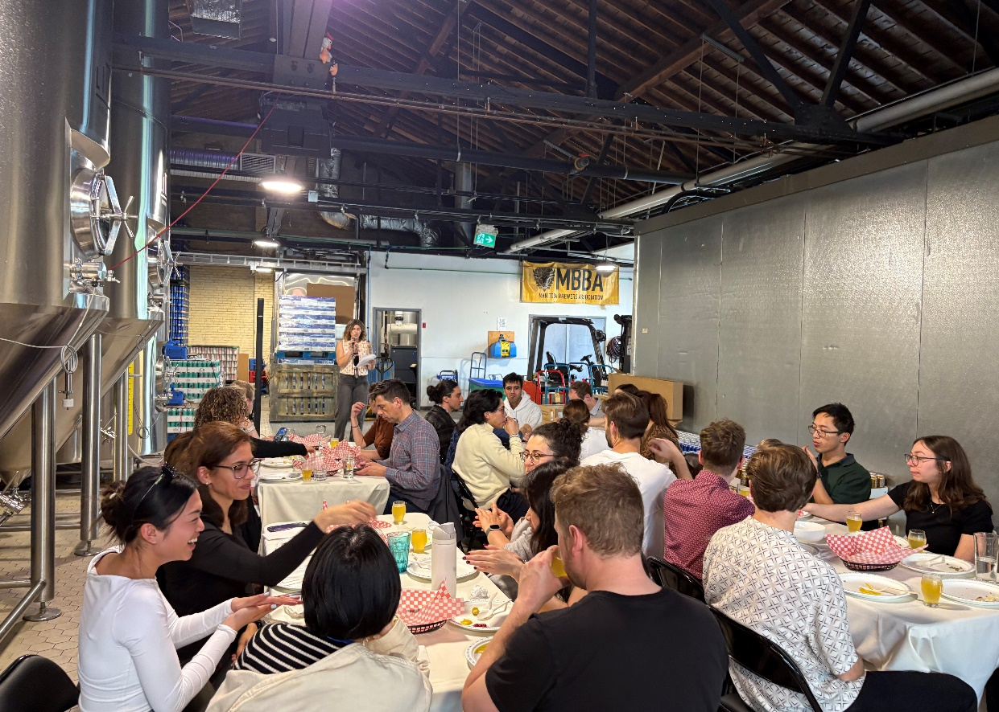
WAC General Business Update
Networking Events
Winter 2024
Volunteer Events
Harvest Manitoba
Siloam Mission
Spring 2025 Event
Little Brown Jug Beer Tasting
Upcoming Events
Summer Event
Volunteer Event

Slide 9
WAC General Business Update
Financials
All 2023 dues collected
Majority of 2024 dues collected
Club’s financial position remains strong
CIA has once again provided a $3,000 sponsorship to use as we see fit

Slide 10
WAC General Business Update
Election Procedure Update
Proposed change to the Board of Directors election procedure
Goal of proposed changes:
  Provide a formal process for candidates to indicate their intention to run
  Modernize voting process
Draft of WAC constitution with intended changes sent to members May 20th, 2025
Feedback received and taken under review
Update will be sent prior to the Fall 2025 Semi-Annual meeting and a vote on the change to the constitution will take place via email voting as per the current constitution
Notes:
WAC board of directors would like to implement changes to the election procedure

Slide 11
WAC General Business Update
U of M Scholarship Eligibility Proposal
Proposed change to the eligibility of the WAC scholarships
Goal: address changes to the CIA’s qualification pathways
Current criteria:
  “has successfully completed at least one professional examination set by the Society of Actuaries/Casualty Actuarial Society”
Proposed criteria:
  “has successfully completed at least one professional examination set by the Society of Actuaries/Casualty Actuarial Society or has successfully completed at least one of the mandatory courses under the Canadian Institute of Actuaries’ University Accreditation Program”
Notes:
Meant to address changes to the CIA’s qualification pathways
Meeting Voting Procedures:
A motion and a seconder to the motion must be made to begin a vote.
I motion to begin the vote on whether or not to change the scholarship eligibility
[co-president] second the motion
A quorum for the transaction of any meeting vote shall be defined as the number of members in attendance.
Approval of a meeting vote requires a majority vote, except for the establishment of another Committee, which requires the approval of two-thirds of the members present at the meeting.

Slide 12
Open Floor
Notes:
[]:
And that concludes the formal part of the meeting – We will now open the floor if you have any questions, comments, or concerns.

