Slide 1

Resilience in Practice: Lessons from Canada’s Catastrophic Events
By: Emilia Cameron, Manager of Climate Resilient Communities
December 11, 2025

Slide 2
The Institute for Catastrophic Loss Reduction
Multidisciplinary severe weather research institute
Scientific research, policy advocacy, and collaborations
Flooding, wildfires, severe wind and hail, and seismic activity
Inform building codes, insurance policies, and community planning to reduce losses
Affiliated with Western University
Over 120 insurer members

Slide 3
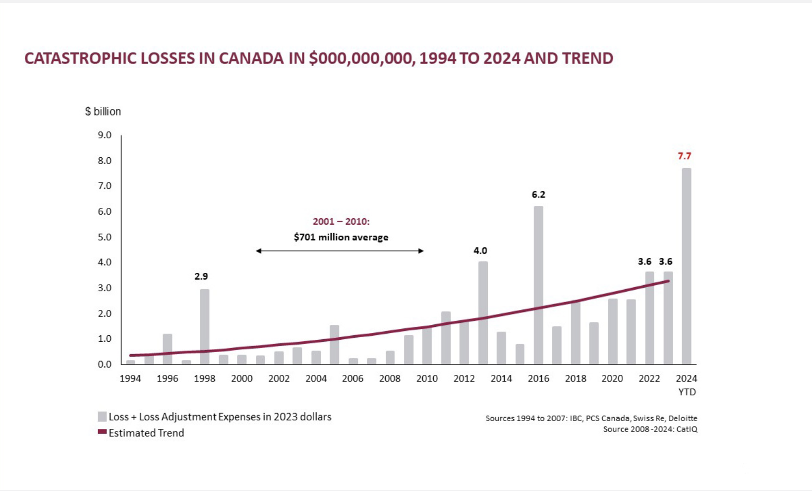

Slide 4
Frequency
Severity
Exposure
These trends undermine the assumption of stationary
Affects pricing adequacy, capital planning, and catastrophic modelling

Slide 5
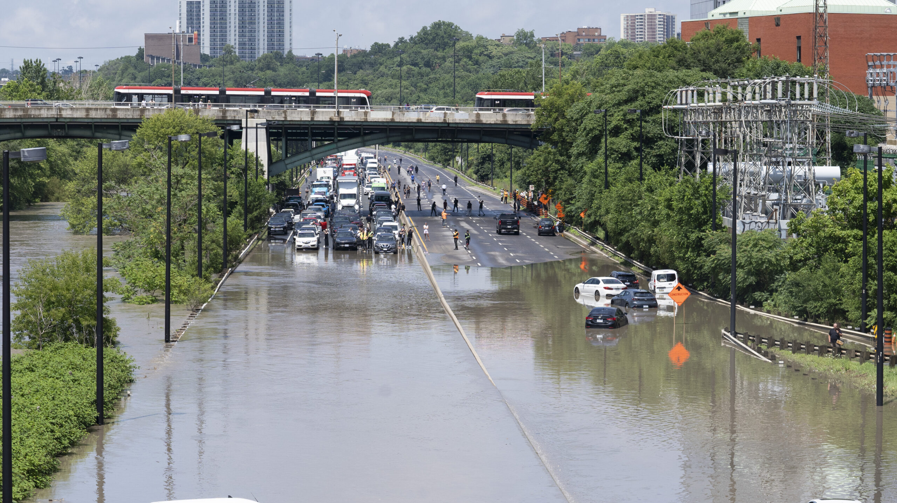
July 2024 Toronto/Southern Ontario Floods
$990 million in insured damage

Slide 6
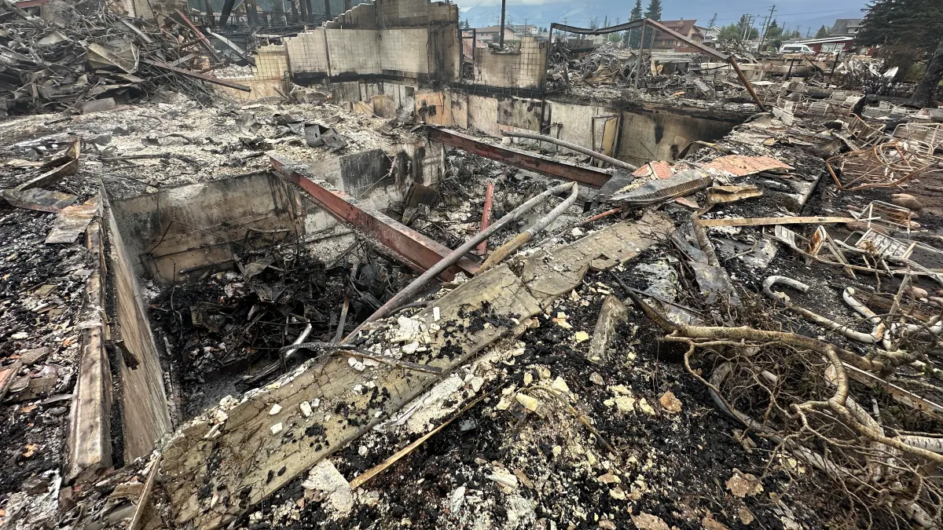
July 2024 Jasper Wildfire
$1.2 billion in insured losses

Slide 7
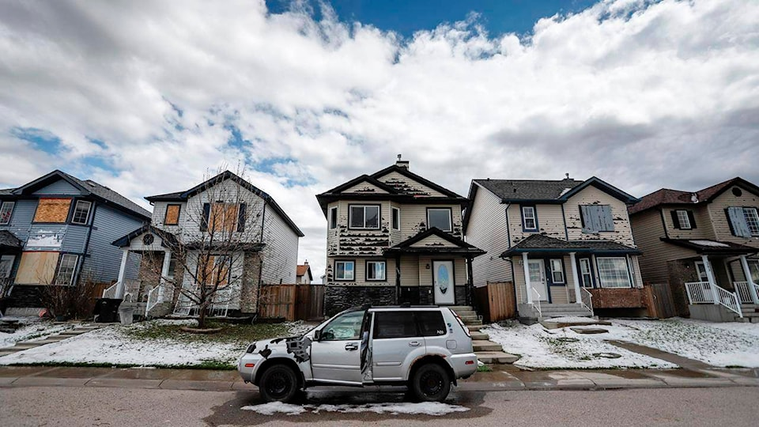
August 2024 Calgary Hailstorm
$3.1 billion in insured losses

Slide 8
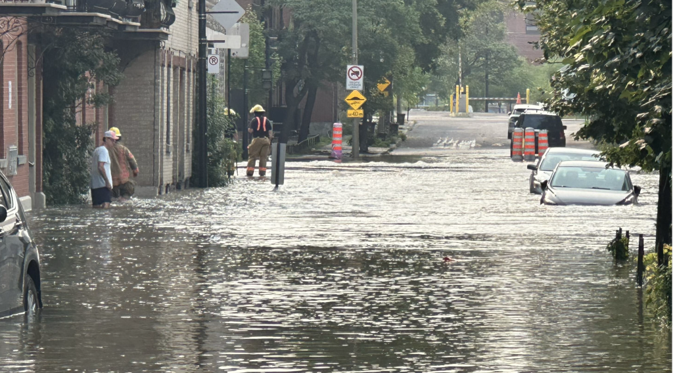
August 2024 Quebec Floods
$2.7 billion in insured damage

Slide 9
2025 to Date: What we are seeing
Wildfire
Extreme weather
Urban flooding
Public disaster relief trends

Slide 10
Actuarial Themes Emerging
Non-stationary is now the baseline
Multi-peril correlation is increasing
Infrastructure fragility as an unmodelled driver
Evacuation driven losses are rising

Slide 11
What Actually Reduces Losses

Slide 12
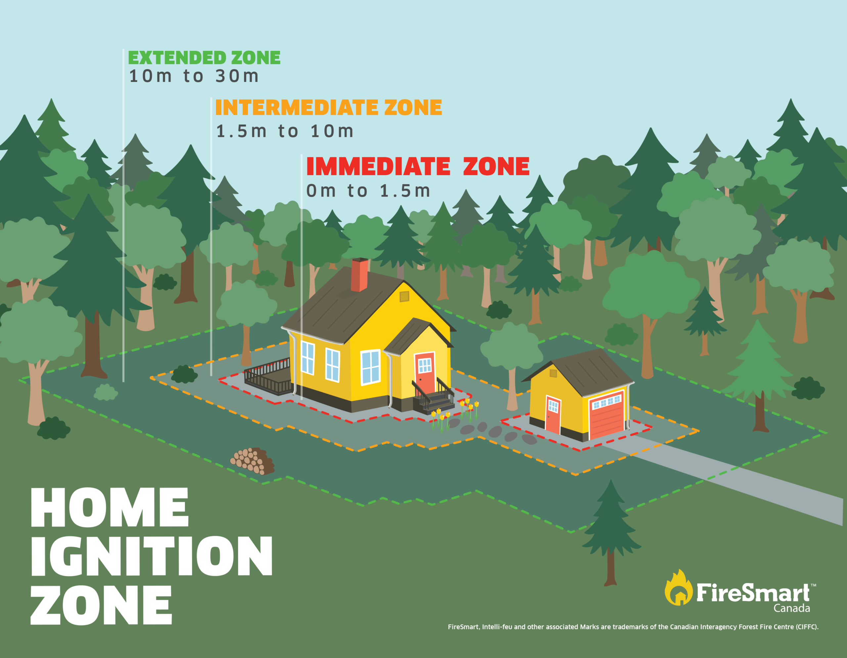
Wildfire
Non-combustible siding, roofing, ember resistant vents, meshing, vegetation management.
Maintaining property

Slide 13
Flooding
Riverine Flooding
Avoid living in a floodplain
Flood barriers
Built the home up
Proper drainage
Flood insurance if eligible
Basement Flooding
Backwater valve
Sump pump and backup sump pump
Lot grade
Disconnect downspouts

Slide 14
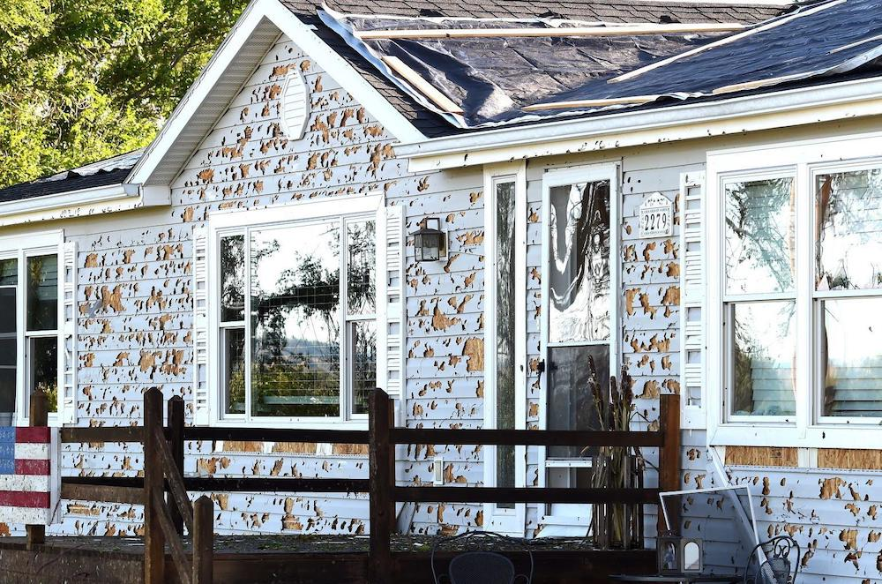
Wind and Hail
Class 4 impact resistant shingles
Stronger nails
Hurricane straps
Fiber cement siding
Protect vehicles

Slide 15
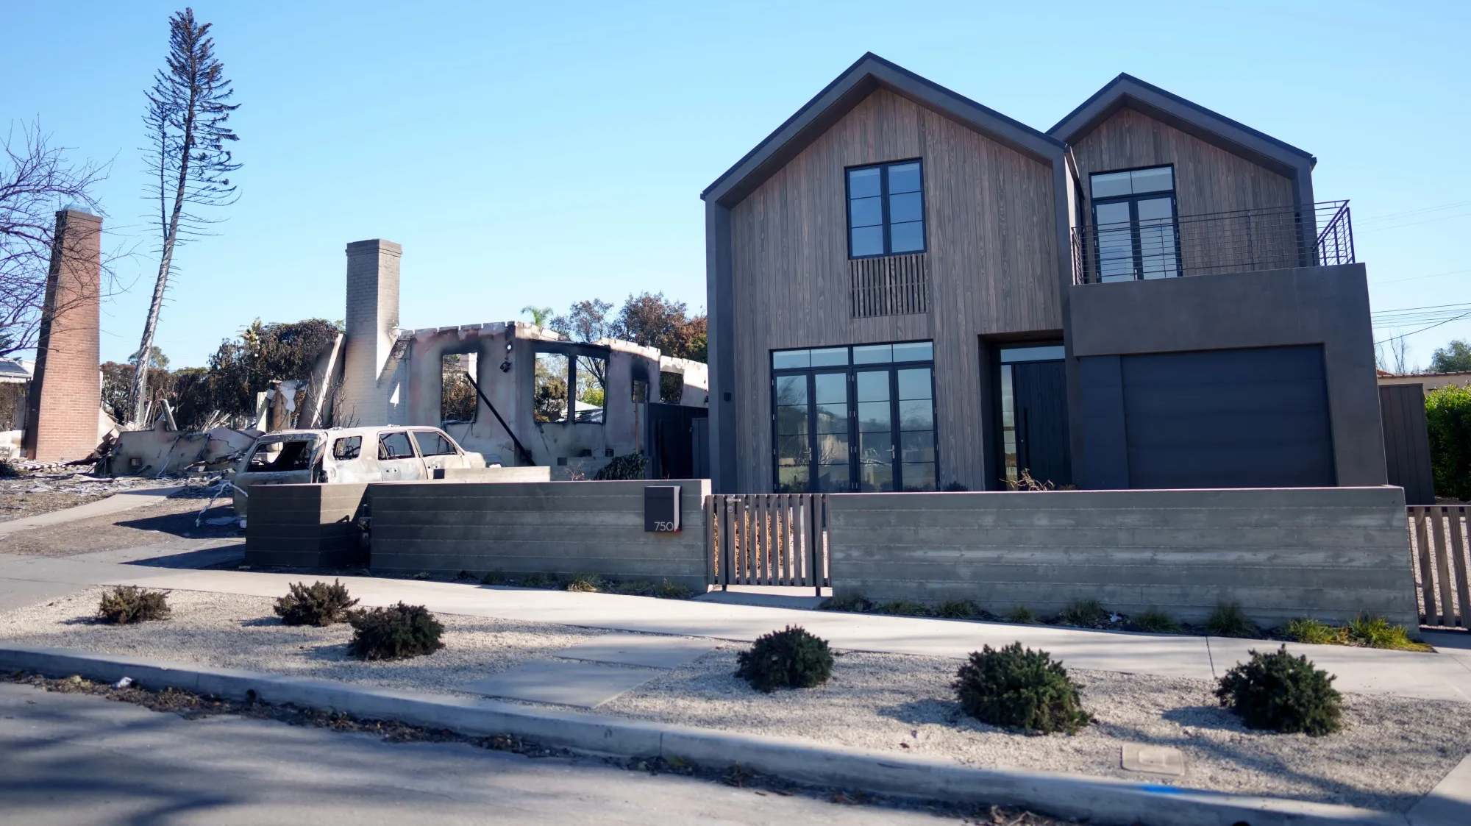

Slide 16
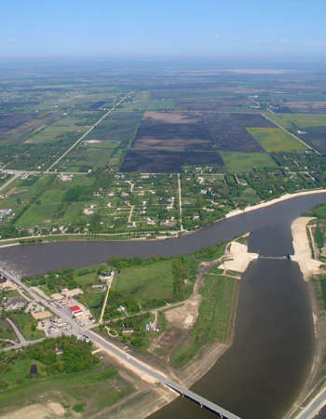
Winnipeg Mandatory Flood Regulations
Winnipeg has very low elevation and sewer infrastructure is vulnerable
All new homes in Winnipeg are required to install a backwater valve and sump pump system
One of the first municipalities to enact this regulation
Red River Floodway

Slide 17
Going Forward
Integrate physical climate risk into pricing and capital planning
Prioritize mitigation signals in underwriting models
Support data driven incentive and resilience programs
Strengthen communication across the insurance ecosystem

Slide 18
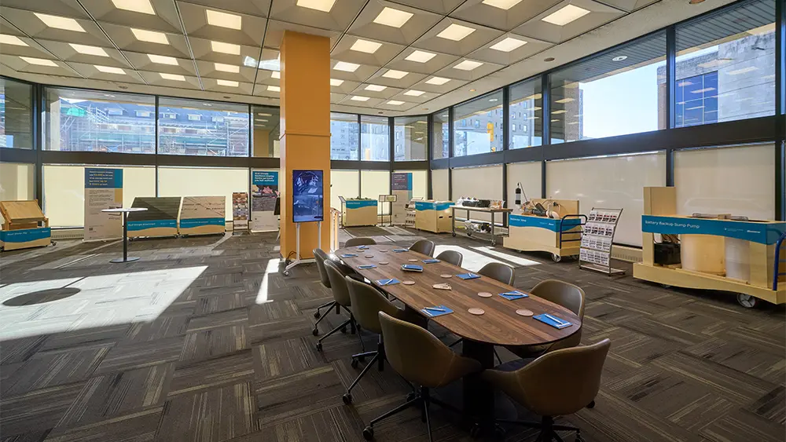
ICLR Resilience Display Centre
Teaches practical, cost effective, consensus-based methods to become more resilient
Hands on displays, videos, interactive kiosks, and more
Basement & riverine flooding, wildfire, severe wind, and hail
Goal: Increase awareness and knowledge on how to make homes and communities more resilient
Centres in London, ON, Toronto, ON and Winnipeg, MB
Location: 191 Broadway

Slide 19
Closing
Opportunity
Actuaries are uniquely positioned
Leadership is essential for
  Ensuring adequate pricing
  Supporting capital resilience
  Designing sustainable insurance products
  Informing land use and building policy
  Steer toward mitigation-based strategies

Slide 20
Thank you!
ecameron@iclr.org
www.iclr.org

