Slide 1
Impact of Wildfire Events on Insurance Practice
Jiali Wang
(M.Sc. research supervised by Dr. Xikui Wang)
Warren Centre for Actuarial Studies and Research
Asper School of Business
University of Manitoba
Presented at Winnipeg Actuaries' Club (WAC)
Semi-Annual Meeting - Spring 2024
Wednesday, May 29, 2024

Slide 2
Table of Contents
Background
Statistical Analysis on Wildfire Events
Application in Catastrophe Reinsurance
The Prediction of 2024
Impact on Life insurance
Discussion

Slide 3
1. Background - Global temperatures
Global temperatures rose about 1.98° F(1.1°C) From 1901 to 2020
The 10 warmest years from 1850 to 2023 have all occurred in 2014-2023.
Source: National Oceanic and Atmospheric Administration(NOAA) and National Centers for Environmental Information (NCEI)

Slide 4
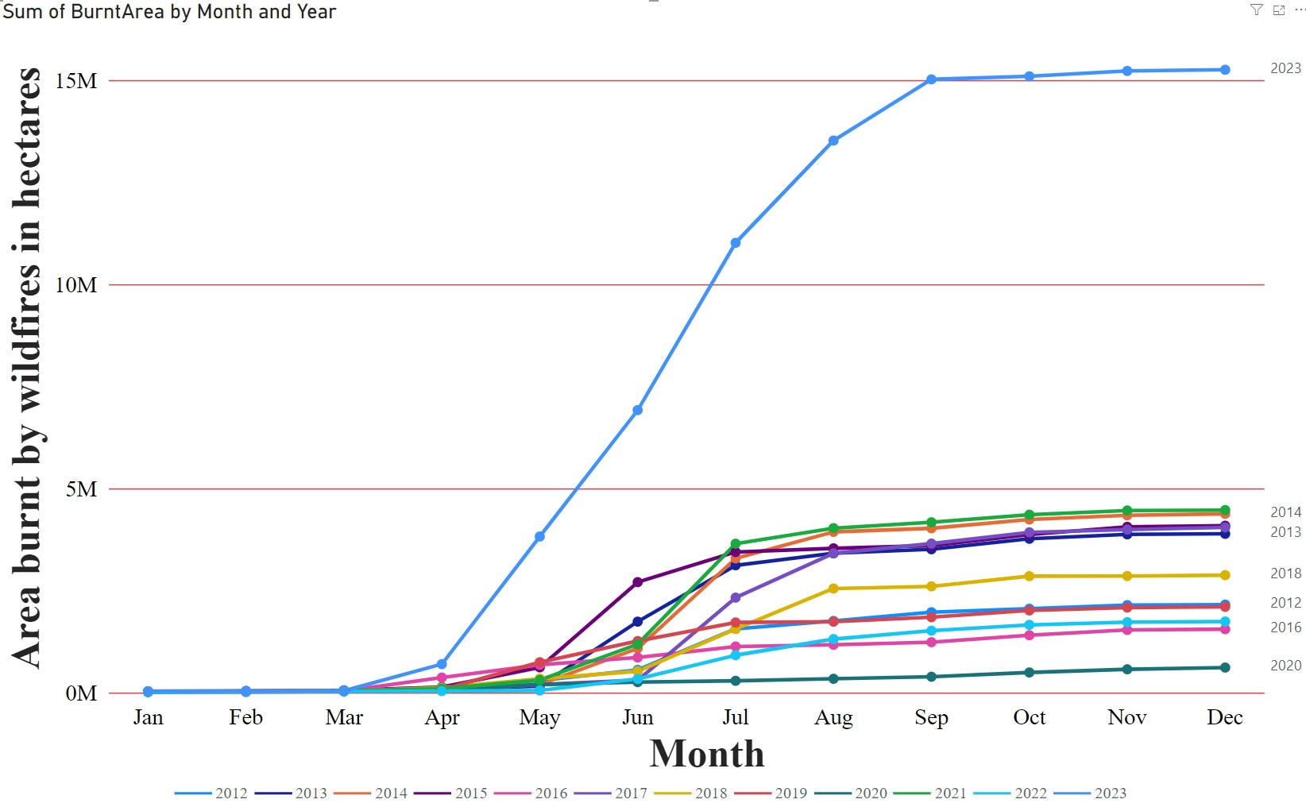
1. Background - Temperature and Wildfire in Canada
Burnt Area by Wildfire in Canada (2012-2023)
15 Million Hectares ≈ 1.5% of Canada's total area
Source: https://climate.weather.gc.ca/historical_data/search_historic_data_e.html / https://ourworldindata.org/wildfires
Notes:
It was the warmest summer in 76 years, dating back to the start of national record-keeping in 1948. The average temperature anomaly was +2.0°C
100 Hectares = 1 Square Kilometer/ 15 Million Hectares = 150,000 Square Kilometer/ Canada's total area= 9,984,670 Square Kilometer

Slide 5
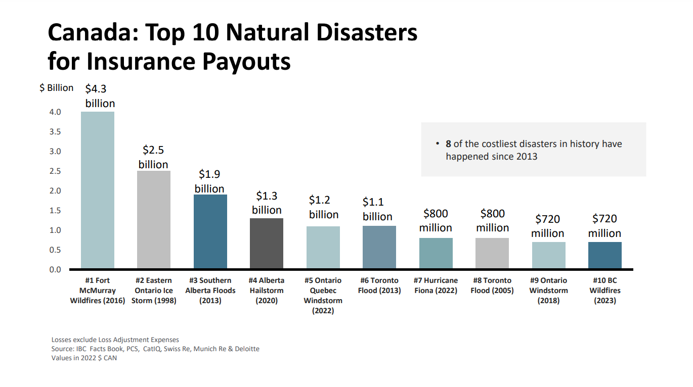
1. Background - Catastrophe Insurance Losses in Canada
Large Wildfire Losses in 2023
August 15–September 25:
Kelowna and Bush Creek East Wildfires ($720 million)
May 28–June 4:
Tantallon, Nova Scotia ($165 million)
August 13–September 16:
Yellowknife and Hay River, Northwest Territories ($60 million)
Source:
https://www.ibc.ca/news-insights/news/severe-weather-in-2023-caused-over-3-1-billion-in-insured-damage
https://www.ibc.ca/news-insights/news/okanagan-and-shuswap-area-wildfires-cause-over-720-million-in-insured-damage
Notes:
Insured Damage for Severe Weather Events in 2023 (9 Events)
(August 24: Winnipeg hailstorm – $140 million)

Slide 6
2. Statistical Analysis on Wildfire Events - Factors
2016: Fort McMurray Wildfire (May 03)
May 3, 32.8 °C (91 °F)
May 4, 31.9 °C (89 °F) and winds gusted to 72 km/h (45 mph).
2021: Lytton Creek Wildfire (June 30)
June 29, 49.6 °C (121.3 °F), winds of up to 71 km/h
2023: Kelowna and Bush Creek East Wildfires (August 18)
July: Average temperatures of 2 degrees Celsius above normal during the summer, with extremely low amounts of precipitation.
Canadian Forest Fire Weather Index
(FWI)
Temperature
Relative humidity
Wind speed
24-hour precipitation
Source: https://cwfis.cfs.nrcan.gc.ca/background/summary/fwi
Notes:
The village had been setting Canadian temperature records in the previous days, including reaching 49.6 °C (121.3 °F) the previous day, the highest temperature ever recorded in Canada.

Slide 7
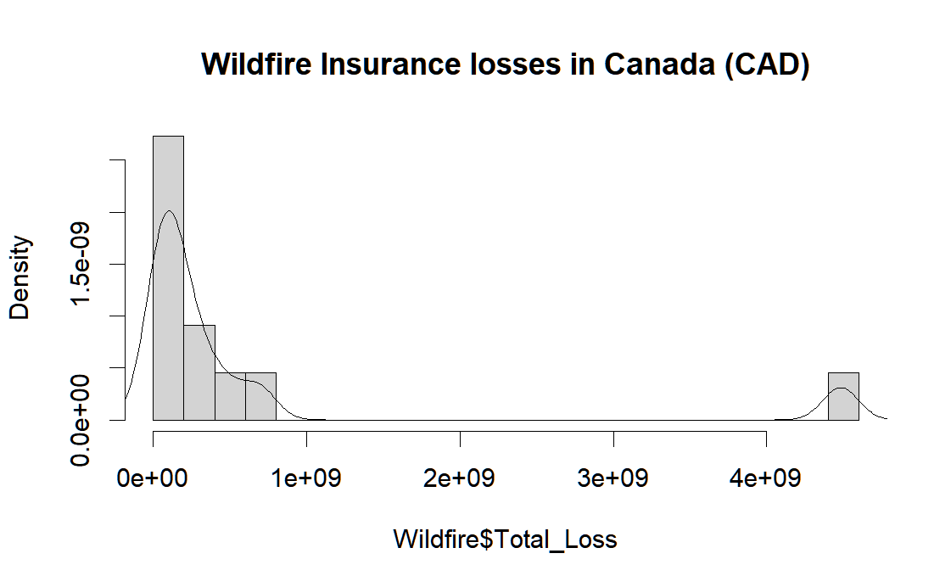
2. Statistical Analysis on Wildfire Events - Distribution
Name: Fort McMurray Wildfire
Dates:
May 03, 2016 - May 19, 2016
Province(s): AB
Location(s): Fort McMurray

Slide 8
3. Application in Catastrophe Reinsurance – Wawanesa CAT XOL 2022
Layer | Limit | Deductible | Reinstatement | Burning Cost Price |  | Ratio
 |  |  |  | All losses | Wildfire Only
1 | 50,000,000 | 50,000,000 | All layers: 1 at pro-rata amount | 23,769,595 | 8,321,002 | 35%
2 | 100,000,000 | 100,000,000 |  | 20,301,515 | 16,642,004 | 82%
3 | 100,000,000 | 200,000,000 |  | 16,244,463 | 16,244,463 | 100%
4 | 500,000,000 | 300,000,000
5 | 1,000,000,000 | 800,000,000
Total Loss
Premium Trends
Market share
(7%-8%)
Proportional Treaty and Facultative Reinsurance(0%)
Brokerage and other expenses
Burning Cost Price
Inflation
(in 2023 CAD)
Source: 2022 Wawanesa Mutual Audited Consolidated Financial Statements
Notes:
GNPI: 4 Billion, may overestimate the price. 8% market in Alberta.
Premiums ceded to reinsurers: About 200 Million

Slide 9
3. Application in Catastrophe Reinsurance – Wawanesa CAT XOL 2022
Although only two of the top ten insurance losses are wildfires, the impact on insurance companies is significant.
Due to Fort McMurray Wildfire, a significant portion of the price of CAT XOL is due to wildfire losses.

Slide 10
4. The Prediction of 2024 - Temperature
National Oceanic and Atmospheric Administration (NOAA)：
22% probability that 2024 will be the warmest year on record
99% likelihood that it will rank among the top five warmest years ever.
Source:
https://climate.weather.gc.ca/historical_data/search_historic_data_e.html
https://www.ncei.noaa.gov/news/global-climate-202401

Slide 11




4. The prediction of 2024 – Wildfire Events
Fort McMurray Forest Area Wildfire in 2024
May 1
May 3
May 6
May 10
May 10, 2024 9 a.m. : Alberta Wildfire is responding
to an out of control wildfire.
May 10 : Highest temperature 28 °C.
May 18
99.5% confident that the probability of occurring wildfire with losses exceeding CAD 25M is less than 22%.
Source: https://srd.web.alberta.ca/fort-mcmurray-area-update/all

Slide 12
5. Impact on Life insurance
Wildfire Smoke
O₃
SO₂
Air Quality
Health
Respiratory issues
Mental health stressors
Damage to critical health infrastructure
NO₂
PM2.5
Air Quality Health Index (AQHI)
Air Quality Benefits Assessment Tool (AQBAT)
For wildfires in 2013–15 and 2017–18
Short-term exposure: 54–240 premature mortalities (per year) | Acute health impacts: $410M-$1.8B (per year)
Long-term exposure: 570–2500 premature mortalities (per year) | Chronic health impacts: $4.3B-$19B (per year)
-From Health Canada & Environment and Climate Change Canada & British Columbia Centre for Disease Control
Source:
https://changingclimate.ca/site/assets/uploads/sites/3/2021/05/National-Issues-Report_Final_EN.pdf
https://ostr-backend-prod.azurewebsites.net/server/api/core/bitstreams/918e5d4a-5eca-416b-a887-148793c1b033/content
https://www.canada.ca/en/public-health/services/publications/healthy-living/wildfires-canada-toolkit-public-health-authorities.html#a5.4.1
https://www.canada.ca/en/health-canada/services/publications/healthy-living/wildfire-smoke-health.html
Health impact analysis of PM2.5 from wildfire smoke in Canada (2013–2015, 2017–2018)
Notes:
The Air Quality Benefits Assessment Tool (AQBAT) is a computer application developed by Health Canada which is designed to estimate the human health impacts of changes in Canada’s ambient air quality.
The analysis estimated annual premature mortalities ranging from 54–240 premature mortalities attributable to short-term exposure and 570–2500 premature mortalities attributable to long-term exposure, as well as many non-fatal cardiorespiratory health outcomes. The economic valuation of the population health impacts was estimated per year at $410M–$1.8B for acute health impacts and $4.3B–$19B for chronic health impacts for the study period. The health impacts were greatest in the provinces with populations in close proximity to wildfire activity, though health impacts were also noted across many provinces indicating the long-range transport of wildfire-PM_{2.5}.

Slide 13
5. Impact on Life insurance
Firefighters
2023: 86 firefighters died in line of duty or from job related illnesses
Water Quality
Build-up of ash
Soil erosion
Fire debris
90% of firefighter deaths in Canada are attributable to a form of cancer
2009-2018: 738 firefighter fatalities reported in Canada
Pipes, meters, and wellheads are burned or exposed to heat
Firefighters had an increased risk of asthma consultation after Fort McMurray Fire.
- Alberta Administrative Health Database
Source:
https://www.manulife.ca/business/news/group-benefits-news/preparing-for-the-effects-of-wildfire-smoke.html
https://www.greenevillesun.com/opinion/cartoons/canada-wildfire-smoke/article_8d64d91a-061f-11ee-881b-b7afb6659ee2.html
https://www.npr.org/2024/04/18/1245068810/wildfire-smoke-contributes-to-thousands-of-deaths-each-year-in-the-u-s
https://www.cbc.ca/news/canada/ottawa/fallen-firefighters-memorial-1.6962211
Association Worker’s Compensation Boards of Canada (AWCBC)
https://journals.lww.com/joem/fulltext/2021/09000/respiratory_outcomes_of_firefighter_exposures_in.7.aspx
Notes:
wildfire smoke is more harmful than other tiny particles, like pollution from fossil fuel combustion or fine dust. It's likely more harmful smoke is produced when wildfires burn through urban areas, where everything from houses full of insulation to car batteries, and metal are torched. ozone
sulphur dioxide
nitrogen dioxide
carbon monoxide
volatile organic compounds
fine particulate matter (PM_{2.5})
These particles penetrate deep into people's lungs and can cross into the bloodstream or even into the brain.
Physician and researcher Juan Aguilera, now at the University of Texas School of Public Health in El Paso, has studied the impacts of air pollution on his patients' health.
Study finds that short-term exposure to smoke from 2016 Fort McMurray wildfires in Alberta affected lung function

Slide 14
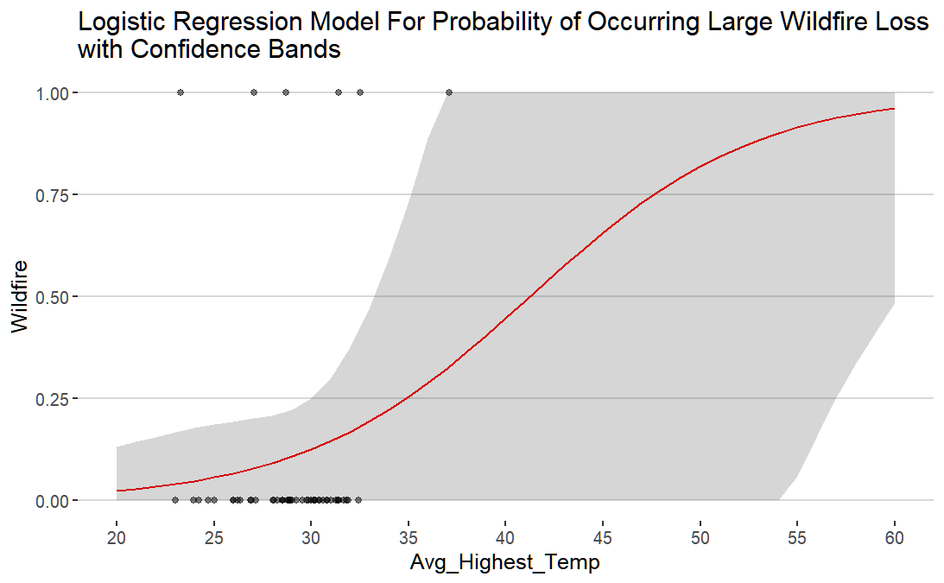
6. Discussion
Goodness of fit for heavy-tail distributions
Calculating Value at risk (Var)
Calculating the best parameters
Layers of Excess of Loss Reinsurance
(10 to 200 year return period)
Pricing for Excess of Loss for Wildfire Losses (TVar)
Fort McMurray Wildfire

Slide 15
WAC Annual Meeting 2024
Thank you for your feedback

