Slide 1
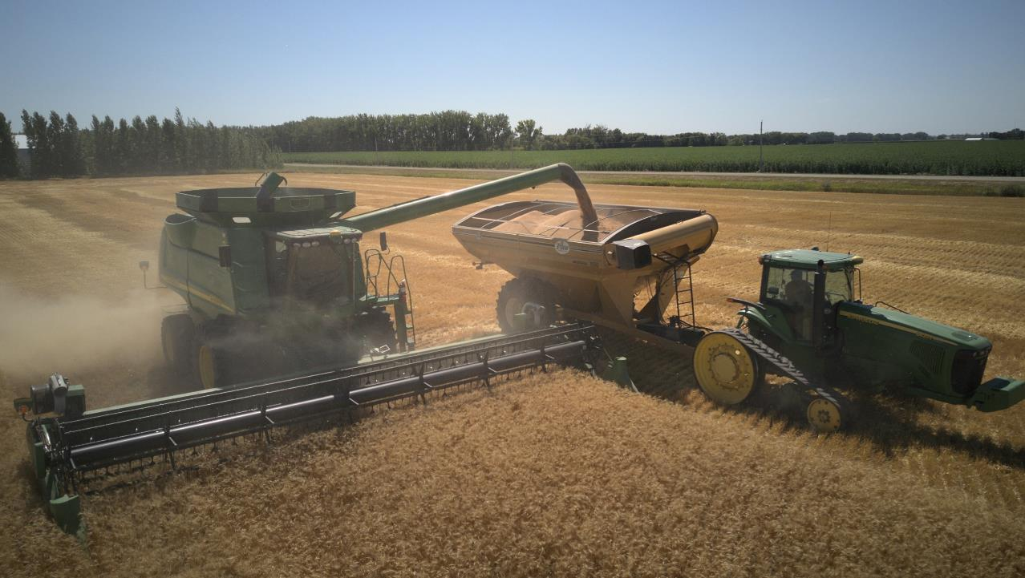
Farming: a Risky Business
Join at slido.com #WAC2023
Notes:
I’m gonna talk a little about my career and the risks that I manage as a farm in Manitoba.

Slide 2
Pallister Farm
-19,000 acre special crops farm north of Portage.
-We conduct all operations including fertilizer spreading,
planting, herbicide and fungicide spraying, harvesting, and grain hauling.
-We operate with older equipment. Most from 2000-2010 model years.
-24 staff during peak seeding and harvest season.
-Only 4 mechanics working during winter equipment maintenance.
-Lots of walking to manage and scout our farm. What happens if there’s a hail storm?
Notes:
I will start by giving some background on our farm. We are a 5th generational farm, me being the 5th generation. I help manage this operation. I’m more heavily involved in agronomy work, adopting new technologies, and human resources. My older brother is full-time farming as well. Dad is slowly stepping back. We also have a farm manager for day-to-day operations. We are a grain farm only and don’t have any livestock. We actually are a special crops farm. What makes it special is the edible beans for human consumption. Most crop farms grow for livestock feed. We conduct all of the operations ourselves. We don’t have custom work crews that come to our farm. All of our equipment is older. Much of it from the early 2000’s. This means more maintenance and labour expense however less equipment depreciation. We don’t have any agronomists hired, We do that all ourselves. It makes for a lot of footwork, as we have to check our crops to determine weed and disease pressure. It is all very time dependent and one of our sources of risks.
DEFINE: Scouting and inputs

Slide 4
Where is all of the risk?
Production: growing crops, weather dependent. Deciding on input costs.
Marketing: when to sell our crops, and at what price?
Human resource: seasonal labour demands.
Operational: equipment reliability and maintenance. How much to invest in equipment (new vs old)?
Investment: land prices underpin our largest source of asset values.
Notes:
I’m going to quickly touch on all of these 5 major risks on the farm in the following slides.

Slide 5
Production Risk

Slide 6
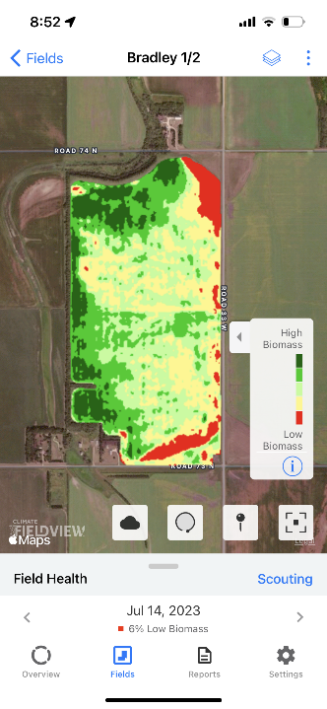
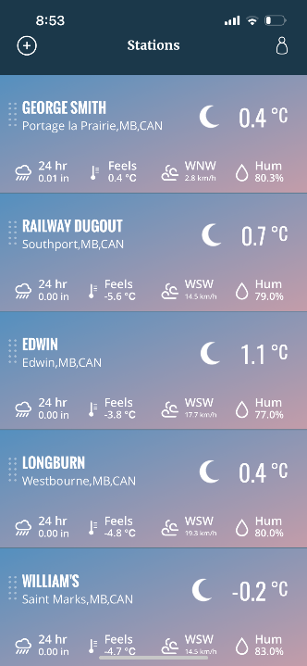
Notes:
Production risk is predictably unpredictable. What I have learned is that every year is different. You learn to dance with mother nature. The largest variable in production is rainfall. If someone could tell me before the year started what days it was going to rain and how much it was going to rain then growing crops would be much easier and cheaper. Most of our expenses are based on what we believe the crop is going to yield. If we think it is going to be a good growing year then we will spend more money on fertilizer, and keep the crop healthier with fungicides. These inputs make the crop more expensive to grow but they are all investments that we hope to get a return on. They are all very time dependent as they have to be done while the crop is at a specific growth stage. The primary way we manage this risk is through production insurance through MASC. We purchase coverage based on our past yield reports. Anther risk that is brought to the table is a knowledge gap between what is going on in the field and what we know as managers. That is where JD operations center, satellite maps, and weather stations come into play.

Slide 7
Marketing Risk

Slide 8
Notes:
Marketing risk is the most unpredictable. Prices for our crops are determined on the futures exchange which is wildly variable, but it doesn’t perfectly match the futures exchange because of local variability in prices as well, called basis. One of the largest determinates of our profit potential but yet by far the least predictable and manageable. We try to manage what we can through selling futures contracts and locking in a price ahead of delivery. However the decision of timing is hugely unpredictable. Our prices at the farm are barely determined by local supply and demand and almost exclusively determined through world events and weather in Europe, the US, and south America. There are not many tools, if any that offer mitigating pricing risk. Only one elevator that I know of offers flexible pricing tools and the ability to lock in minimum prices outside of directly dealing with futures markets. Most farms do not use futures.
We’re not just talking $10 or $15. This is our salary for the entire year.

Slide 9
Human Resource Risk

Slide 10
Notes:
Human resource risk is a big source of stress. Farm labour is super hard to find right now. There are a lot of requirements. I can’t guarantee any weekends in the summer, you have to work long and unpredictable hours, and it is only a seasonal job. It would be very difficult to find labour without EI paying staff through the winter. Most of our seasonal staff is older, retired farmers that don’t have a lot of working years left. What if a key mechanic left right before harvest started? This scenario is the most stressful. Local job ads work but not as well for mechanic positions. There is no insurance product to cover this, so we manage it by hiring extra.

Slide 11
Operational Risk

Slide 12
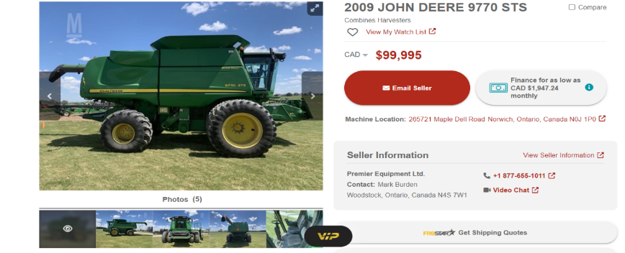
In the market for a combine?
Notes:
Operational risk is where many farms differ in their strategies to operate. With our model of older equipment but more total units, we have less equipment investment but consequently more expense on mechanical labour and parts. It’s this balance between depreciation expenses and these parts and labour expenses. Input expenses by farm such as fertilizer, seed, and chemical won’t change nearly as much by farm as much as land and equipment ownership models. You can also rent equipment as well as land. Another factor is break downs in-season. Since operations are so timely then equipment breakdowns are very risky. The older equipment will be more likely to break down than the newer equipment, except that you can afford so many more older units of equipment, making you less reliant on one new piece of machinery that could have a breakdown and leave you stranded anyways. These prices listed are real ask prices that I pulled off of Marketbook right before my presentation.

Slide 13
Investment Risk

Slide 14
Notes:
Investment risk on the farm is the biggest source of overall risk of ruin. Farmland prices have climbed steady since the 90s with no sign of stopping yet. There actually could be a bubble on farmland prices. They say that farmland can’t go down because they’re not making it anymore. But it has gone down in the 80s when there was high interest rates couples with low commodity prices. A crash in farmland prices could be catastrophic for the farm as 90% plus of our asset value is land. If banks started cancelling mortgages and divesting in agriculture because of a collapse in land prices we would be in trouble. We just don’t have the ability to come up with cash to pay off mortgages without notice. The biggest source of a crash of this magnitude would be a crash in the overall farm economy, likely driven by many years of negative profit margins where farms just can’t make debt payments. All of the risks I talked about previously are motivating us to keep our farm profitabile. If our farm is profitable then we could survive a major crash in farmland values.

Slide 15
Notes:
Here’s an example of farmland prices showing the extreme bubble we are sitting in today and the 80s crash that bankrupt many farms.

Slide 16
Notes:
This chart highlights the path of historic farm profitability. The crucial way to manage land pricing risk is through keeping the farm profitable.
All of the decisions and risks that are managed on the farm are discussed in depth between myself, my brother, and our farm manager. We also consult our accountants quite frequently to make sure we are not missing any angle which makes it less stressful having more of a team approach.

Slide 17
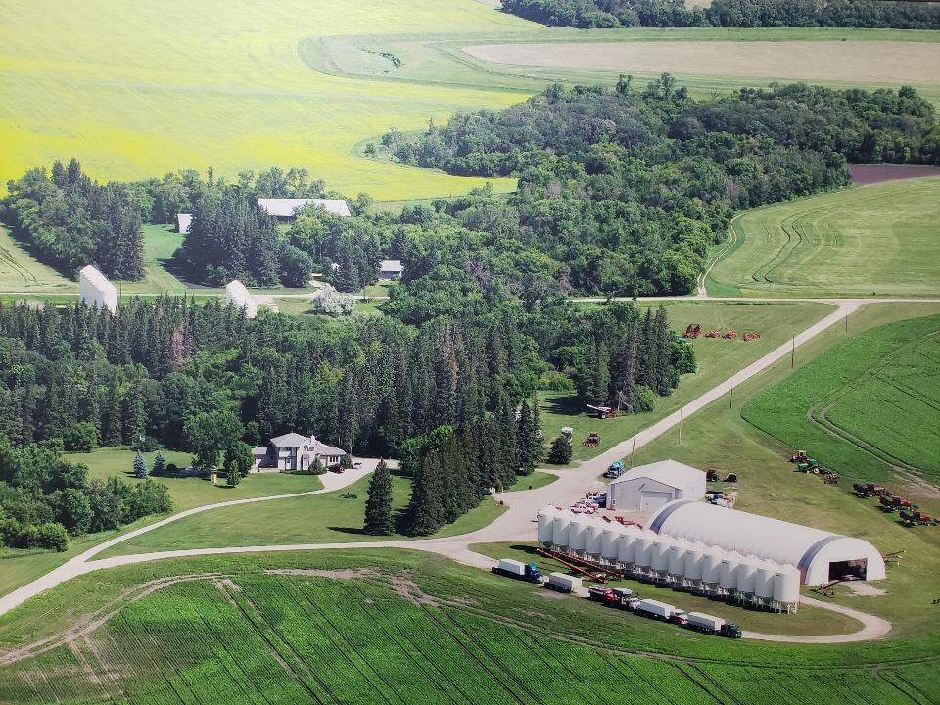
Thank You
Notes:
[Quinn]:
Thanks William!
Next I’d like to welcome our next presenter, Rick Steinke (read bio)
Welcome Rick!
Rick S. Steinke
Canadian Risk Manager
ADM Milling Company – a subsidiary of Archer Daniels Midland Company
Rick Steinke began his career at ADM Milling in June of 2013 just prior to the open market for wheat, durum, and barley August 1, 2013. In his current capacity he and his team are responsible for managing risk for ADM’s flour milling assets in Canada.
Previously Rick held the position of Director of Multi-modal logistics for Viterra and prior to that Vice President of Logistics at the Canadian Wheat Board (CWB). At the CWB Rick held many positions of increasing responsibility including: Director of Global Market Analysis, Marketing Manager, USA, and Manager Sales Planning and Corporate Policy.
He holds a Masters and B.S.A. degree in Agricultural Economics from the University of Saskatchewan.
In his spare time Rick can often be seen training for a marathon which is good practice for his day job managing market risk!

Slide 18
Canadian Flour Market Risk
Join at slido.com #WAC2023
December 6, 2023

Slide 19
Rick Steinke
ADM Milling Canada
Futures and options trading involve significant risk of loss and may not be suitable for everyone. Therefore, carefully consider whether such trading is suitable for you in light of your financial condition. This report includes information from sources believed to be reliable and accurate as of the date of this publication, but no independent verification has been made and we do not guarantee its accuracy or completeness. Any reproduction or retransmission of this report without the express written consent of ADM is strictly prohibited. The information and comments contained herein is provided by ADM and in no way should be construed to be information provided by ADM. Copyright © ADM Investor Services, Inc.

Slide 20
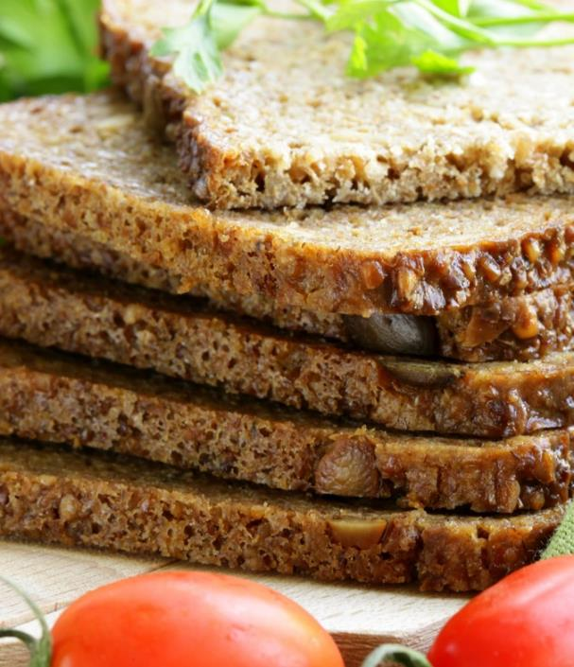
Outline
Risk Types
Price Risk
Fundamental
Technical
Analysis

Slide 21
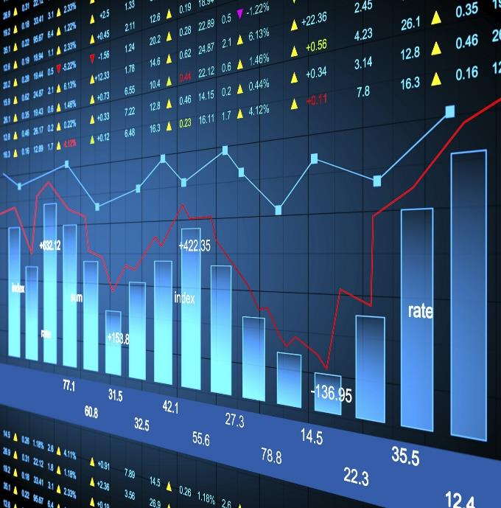
Types of Risk
Price
Execution
Currency
“Risk comes from not knowing what you’re doing” – Warren Buffet

Slide 22
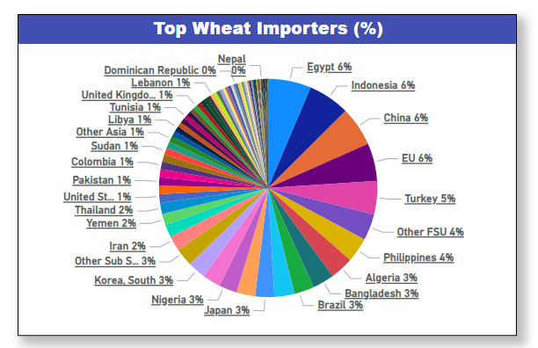
Wheat Price Risk
Wheat Exporters 2023/24
Fundamentals
Supply – yield/area
Weather
War
Corn Base
Demand – exports/domestic/weather
Technical
Marco – Money Flow (equities/currency/virus)
Charts
United States
Ukraine
Argentina
Russia
Australia
Europe
Canada
Source: USDA
Source: USDA

Slide 23
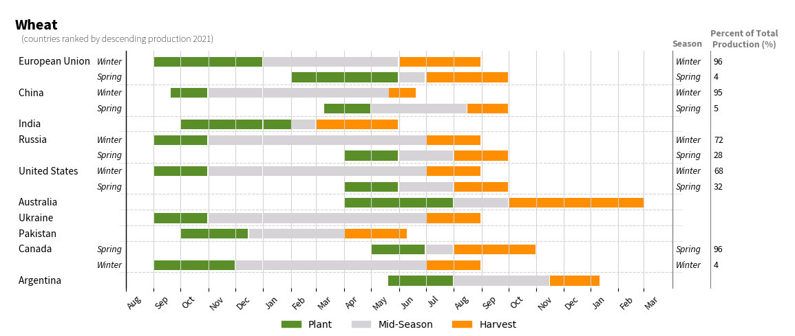
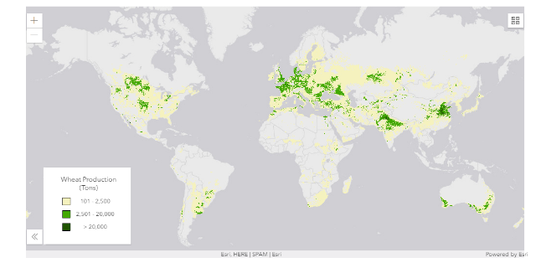
Wheat Supply
Grown in 80 countries
Top 10 countries grow 70% of the wheat
Global growing season
Wheat always growing somewhere in the world
Seven Major Wheat Exporters:
Major Exporters provide 89% of supply
Annual Cereal Plant
Canada 110 day wheat life cycle
Weather impact
Ukraine
Russia
Canada
Europe
Source: USDA

Slide 24
Source: USDA

Slide 25
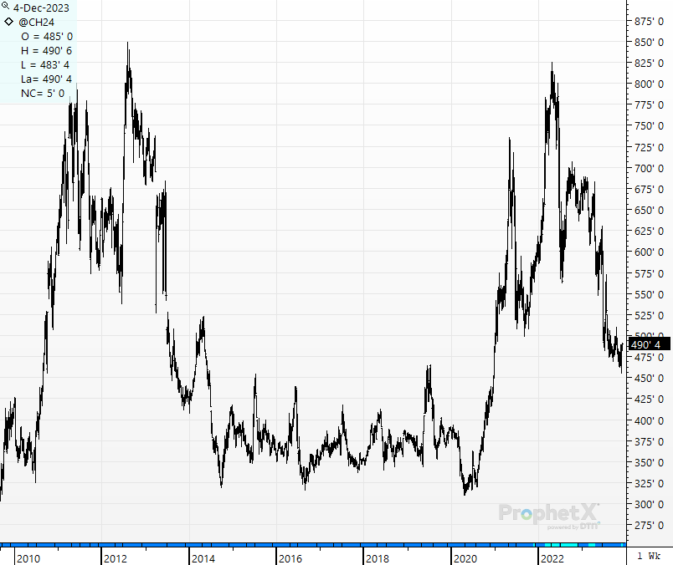
Corn Futures Prices - Chicago

Slide 26
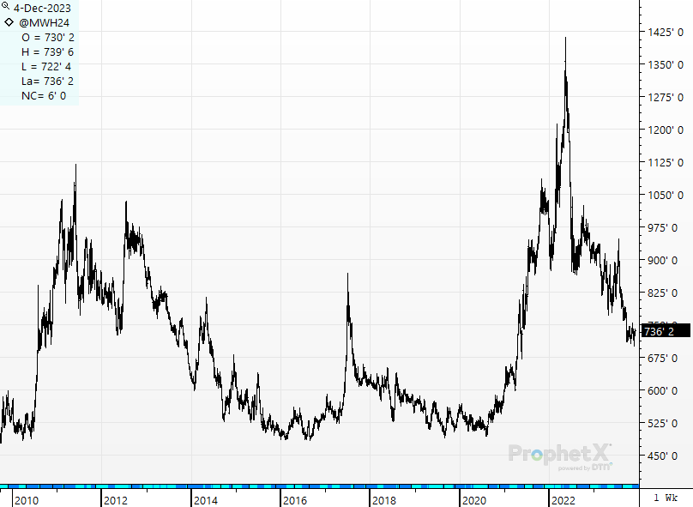
Wheat Futures Prices – MPLS – Hard Flour

Slide 27
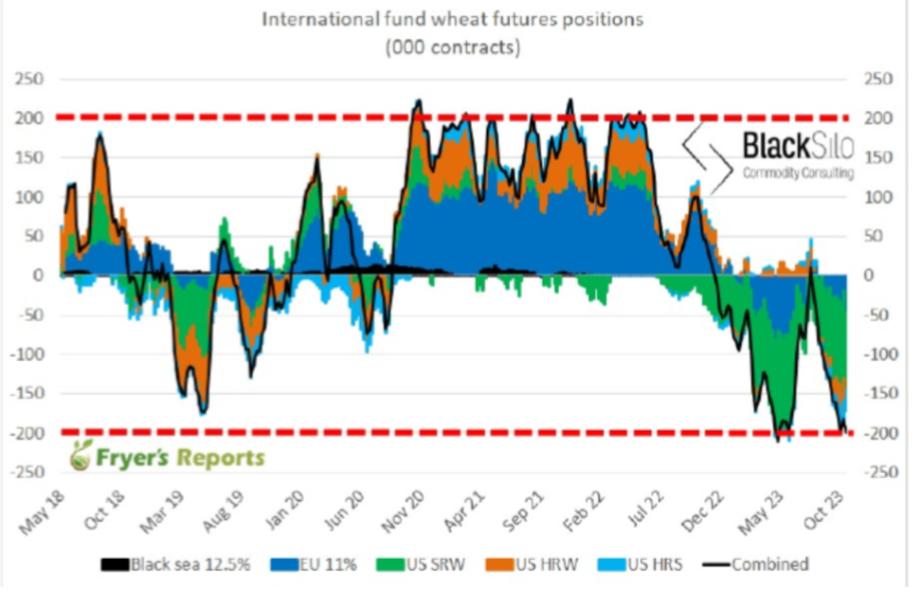

Slide 28
“It’s not that I’m so smart, it’s just that I stay with problems longer” – Albert Einstein
Thank You
Notes:
[Quinn]:
Thanks Rick!
Next, I’d like to welcome our final presenter, Jared Munro (read bio)
Welcome Jared!

Slide 29
Agricultural Risk Management
Join at slido.com #WAC2023
Jared Munro, Chief Executive Officer
December 6, 2023

Slide 30
Manitoba Agricultural Services Corporation (MASC)
Provincial Crown Corporation reporting to the Minister of Agriculture
2022/23 Highlights:

Slide 31
AgriInsurance
Purpose: minimize economic losses resulting from crop production shortfalls and quality losses caused by natural perils by providing risk management protection to individual producers.
Example: Jill grows 1,000 acres of canola and selects 80% coverage. MASC determines the Probable Yield for Jill’s canola to be 50 bushels per acre and provides an insured price of $15/bushel.
Coverage: 50 x 80% x 1,000 = 40,000
Due to drought, Jill only harvests 25 bushels per acre (25,000 total). Her indemnity will be $225,000 ((40,000 – 25,000 = 15,000) x $15/bu))

Slide 32
Government Responsibilities
Provincial Government / Insurance Agency
Designs, develops and delivers the program
Contributes to premium (24%) and administrative costs (40%)
Provides deficit financing
Federal Government
Approves provincial program proposals that are cost-shared and prepares federal-provincial agreements
Provides deficit financing to provinces who choose to participate
Contributes to premium (36%) and administration costs (60%)
Develops and applies national standards for Premium Rates, Probable Yields, Insured Values, Level of Coverage and Insurable Benefits

Slide 33
Weather and Financial Risk

Slide 34
Emerging Risks
Modernization
Farm demographics
Farm management
Technology
Data
Sustainability
Climate change
Environmental linkages
Public support

Slide 35
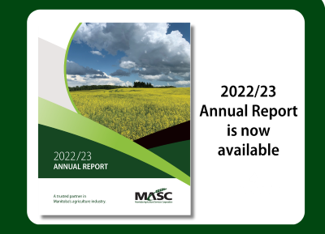
For more information
www.masc.mb.ca
Manitoba Management Plus Program

