Slide 1

Fall 2024
WAC Semi-Annual Meeting
Thursday, November 21st, 2024
Join at slido.com
#WACF2024

Slide 2

Agenda
11:30am – Welcome Reception
11:45pm – Buffet Lunch
12:15pm – Speaker
1:15pm – WAC Business Section & Executive Election
Join at slido.com
#WACF2024
Notes:
Hello everyone!
Thanks for coming to the Fall 2024 WAC Semi-Annual Meeting
We are excited to see everyone here today
We’ll be starting our presentations shortly.
We’ll be using Slido to submit questions for the Q&A after the presentation. Please log in now with the code WACF2024 as shown on the screen.
Feel free to submit questions during the presentation. After the presentation, we will have a Q&A portion.

Slide 3
(Speaker Presentations)
Notes:
Introduce CIA president – Conrad Ferguson

Slide 4


Audience Q&A Session
ⓘ Start presenting to display the audience questions on this slide.
Notes:
Quinn/Braeden to moderate

Slide 5
WAC Business Session
Notes:
We hope you enjoyed the presentation
Thanks to Conrad for joining us (*applause*)
We’ll run though our business update here before concluding the meeting

Slide 6
WAC General Business Update
Agenda
Recent & Upcoming Events
U of M Scholarship Winners
Financial Update
Executive Election
Notes:
We’ll talk about: read list

Slide 7

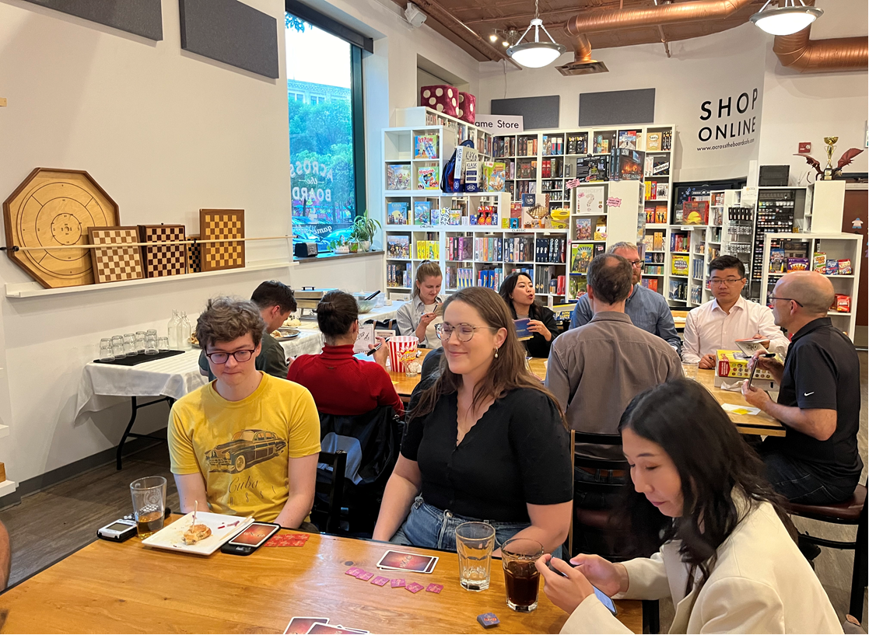

WAC General Business Update
Recent & Upcoming Events
Upcoming Events
Volunteer opportunities
  Harvest Manitoba – Thurs, Dec 12th 9am-12pm
  Siloam Mission – Fri, Dec 13th 8:30am-11am
Networking event
  TBD – Feb/March 2025

Slide 8
WAC General Business Update
U of M Scholarships
Winnipeg Actuarial Club Scholarship: $1000
  Enrolled full-time in Actuarial Mathematics (Commerce or Science)
  Minimum degree grade point average of 3.0
  Successfully completed at least one SOA/CAS professional examination
  Demonstrated leadership through volunteer activities in the community or at the University of Manitoba
Winnipeg Actuarial Club Equality of Opportunity Scholarship: $1000
  Same as above, but self-declared as a First Nations, Métis or Inuit person from Canada or as a visible minority
Notes:
WAC Scholarship Darbara Kaushal
EoO Scholarship - Forogh Tahmasebi

Slide 9
WAC General Business Update
U of M Scholarships
Winnipeg Actuarial Club Scholarship Recipient
  Darbara Kaushal
Winnipeg Actuarial Club Equality of Opportunity Scholarship Recipient
  Forogh Tahmasebi
Notes:
WAC Scholarship Darbara Kaushal
EoO Scholarship - Forogh Tahmasebi

Slide 12
WAC General Business Update
Executive Election
Positions up for Election
Co-President (currently held by Quinn Pallister)
Member at Large (currently held by Tim Rempel)
Treasurer (currently held by Karl Sanderson)
Meeting Voting Procedures:
A motion and a seconder to the motion must be made to begin a vote.
A quorum for the transaction of any meeting vote shall be defined as the number of members in attendance.
Approval of a meeting vote requires a majority vote, except for the establishment of another Committee, which requires the approval of two-thirds of the members present at the meeting.

Slide 13
Open Floor
Notes:
That concludes the formal part of the meeting – We will now open the floor if you have any questions, comments, or concerns.

